Slide 1
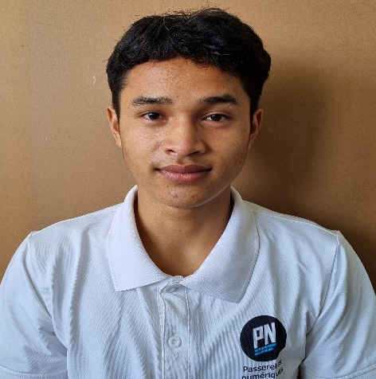



A THI
0355 279 217
thi.a24@student.
Passerellesnumeriques.org
Back-End Intern
101B, Le Huu Trac, Phuoc My, Son Tra, Da Nang
SOFT SKILLS
EDUCATION
Researching
Teamwork
Communication
Problem-Solving
PASSERELLES NUMERIQUES VIETNAM
Bachelors in Information Technology
Oct 2021 – Oct 2024
PROJECT
TECHNICAL SKILLS
DOCTOR BOOKING WEBSITE Jan 2023
HTML, CSS, JavaScript, Github
Linking Mock API, JSON-Server to get Data
Designing validation for form
Designing admin’s interface
Developing main functions: display, search, add
and delete the user’s information
Storaging code using GitHub
HTML & CSS
JavaScript
PHP
MySQL
LANGUAGE
Vietnamese
English
COSMETICS SELL WEBSITE Nov 2022 – Dec 2022
Visual Studio Code - HTML, CSS, Bootstrap
Following the available website
Analyzing how to do and code
Presentation
ACTIVITIES
Giving Gifts
Nov 2022
Team member
Conduct street sales to earn money to buy gifts
Presenting project
RESTAURANT MANAGEMENT Oct 2022 – Nov 2022
Workbench – MySQL
Designing a database
Reading project requirements
Creating tables and making relationships and creating queries
Presentation about project
INTERESTS
REFERENCE
Drinking coffee
Analyzing
Vo Cong Dinh IT Trainer
0905 729 707
dinh.cong@passerellesnumeriques.org

